Slide 1
COMSE 6998
Gummy Lions
🦁

Slide 2
Introduction
🦁

Slide 3

Brick-and-mortar grocery stores
Social impact
“Improve the quality of life of our clients and the community in general ”
Largest & Most well-known
33 locations, 18 chains, 54 stores
2.5 million registered cardholder
43% of the values of food sales
Corporación Favorita
Ecuador
🦁

Slide 4


Traditional Grocery vs New Tech Reforming
Why do we care?
Smarter Schedules
Better Budgets
Challenge?
Demand & Supply Mismatch
Multi-location & Unique Demand
Holiday Effect
Macro economy
Solution?
Innovative Sales Forecasting
🦁

Slide 5
Data Source
Kaggle: https://www.kaggle.com/c/favorita-grocery-sales-forecasting/data
Sample part of the dataset to analyze
🦁

Slide 6
Exploratory Data Analysis
🦁

Slide 7
Daily Sales Trend
🦁

Slide 8
Sales by Day of Week
🦁

Slide 9
Sales by Store
🦁

Slide 10
Holiday
🦁

Slide 11
Holiday Type
🦁

Slide 12
Sales by Location
🦁

Slide 13
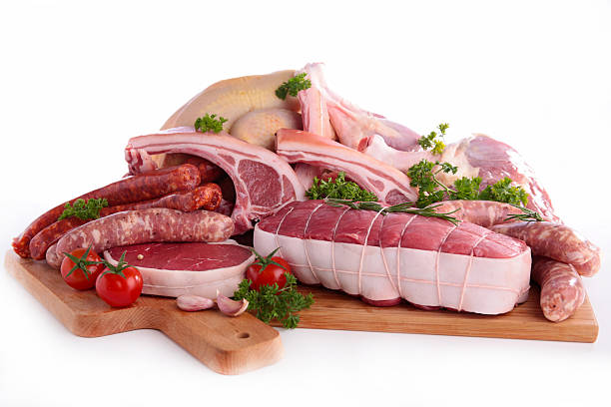
MEATS
Perishable
Daily consumption
Demand fluctuates
Inventory sensitive
Relative to macroeconomy
2432048 transactions
🦁

Slide 14
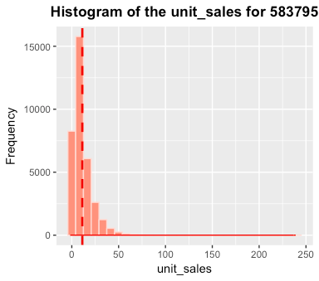
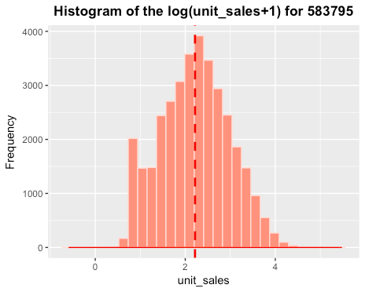
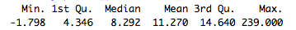
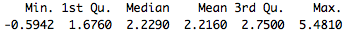
LogMA Model Overview
Taking natural logs of unit_sales data.
Days of week factor
Moving Average prediction
🦁
Notes:
Taking logs:
sales volumes are highly unequal with a heavy right tail in the distribution. We benefit a lot through taking logs

Slide 15
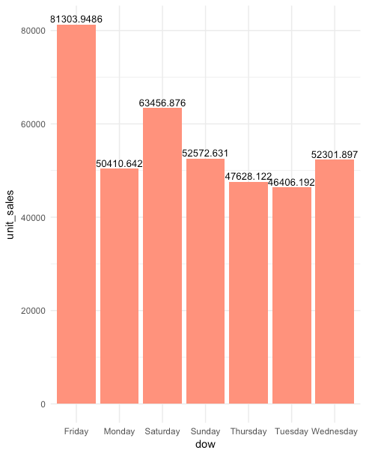
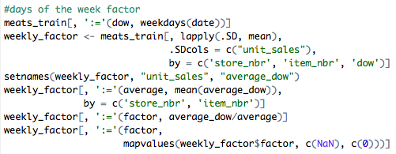
LogMA model Overview
Taking natural logs of unit_sales data.
Days of week factor
Moving Average prediction
🦁
Notes:
Days of week factor
sales volumes are highly unequal with a heavy right tail in the distribution. We benefit a lot through taking logs

Slide 16
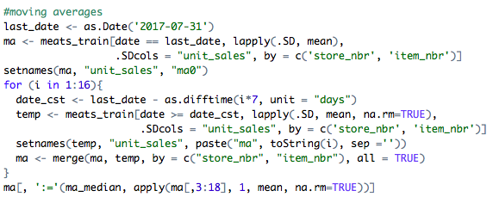
LogMA model Overview
Taking natural logs of unit_sales data.
Days of week factor
Moving Average
🦁
Notes:
Days of week factor
sales volumes are highly unequal with a heavy right tail in the distribution. We benefit a lot through taking logs

Slide 17
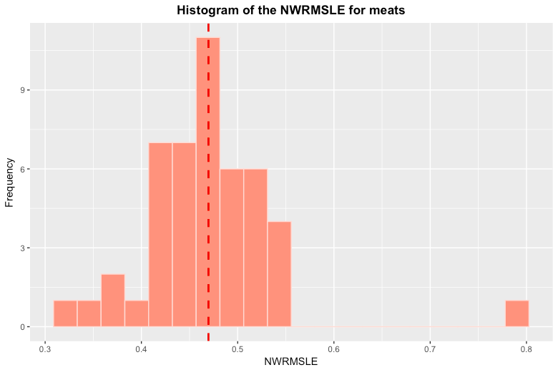
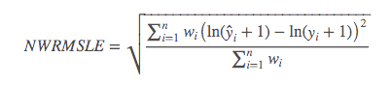
LogMA Model Results
Wi = 1.25 for perishable goods 1 for normal goods
🦁
Notes:
This metric is suitable when predicting values across a large range of orders of magnitudes. It avoids penalizing large differences in prediction when both the predicted and the true number are large: predicting 5 when the true value is 50 is penalized more than predicting 500 when the true value is 545.

Slide 18
Prediction by Prophet
🦁

Slide 19

Report Engine Prototype
🦁

Slide 20
Conclusion
🦁

